Slide 1
Wiki-Health: A Big Data Platform for Health Sensor Data Management

Slide 2
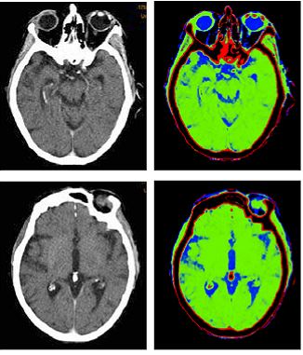
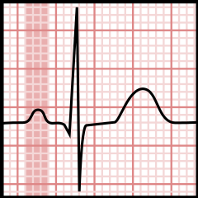
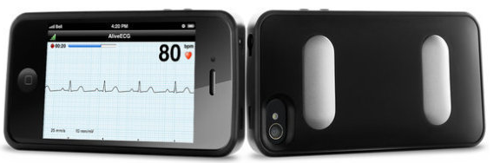
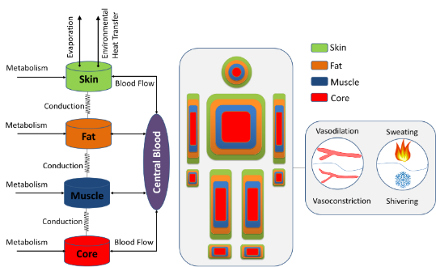
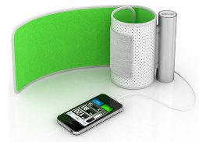
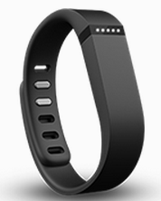
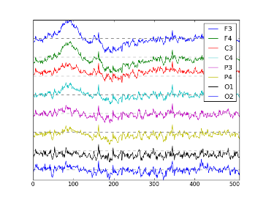
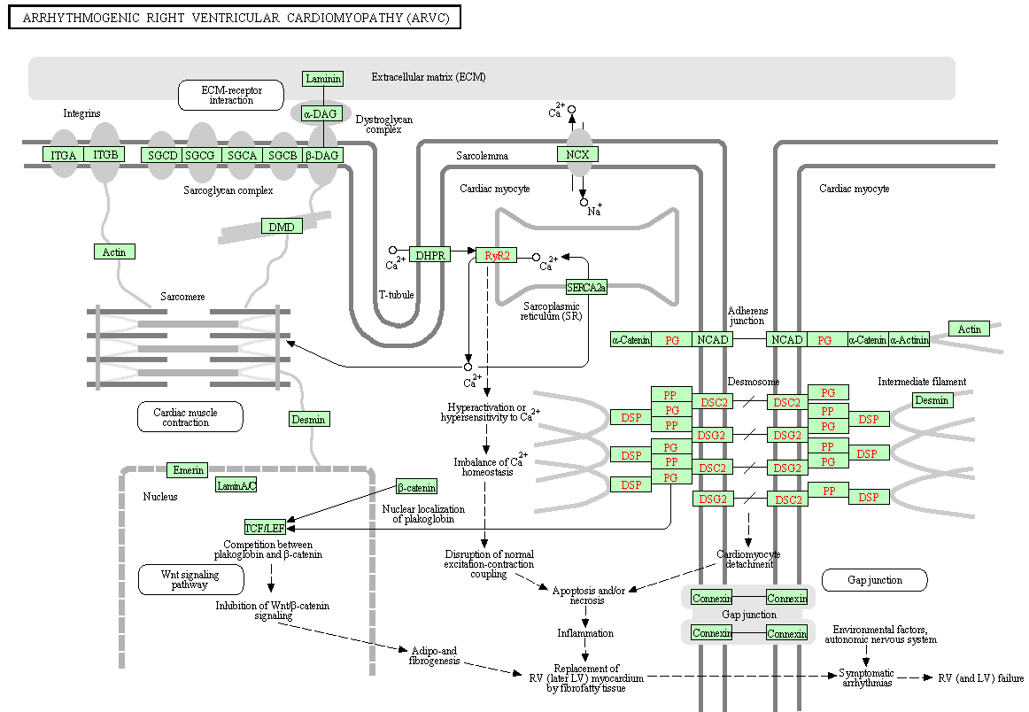
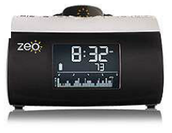
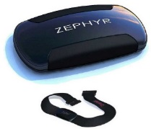
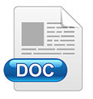


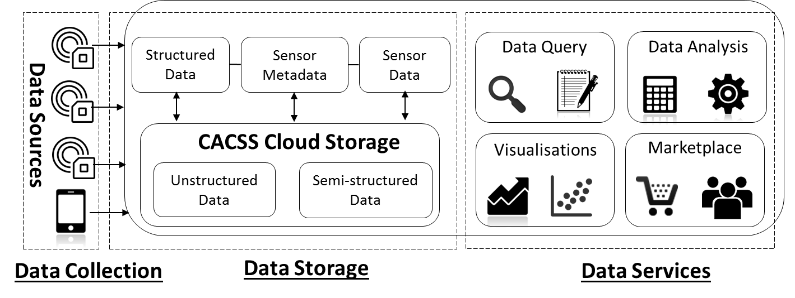
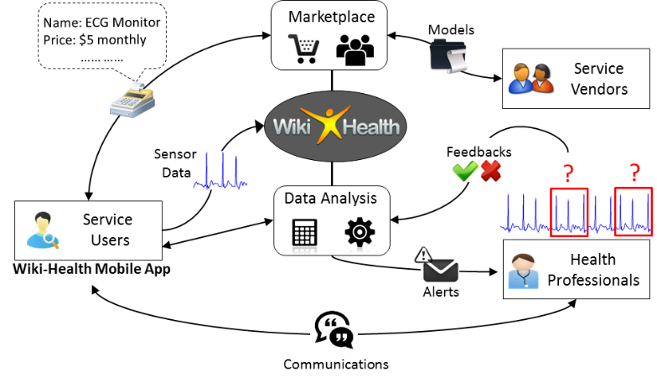
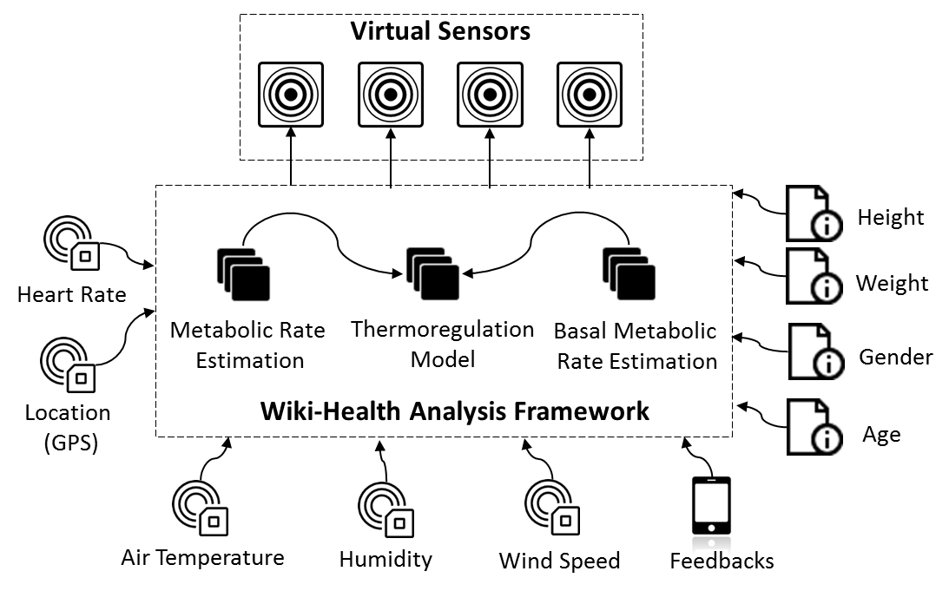
Graphical Abstract
The Challenge
Explosion of Health Data and Sensor Devices
Unstructured
Data
Time-Series Sensor Data
Wireless Sensor Devices
Models and Knowledge
The Solution
Wiki-Health Platform
The Evidence
Health Monitoring as a Service
Virtual Sensing as a Service

Slide 3

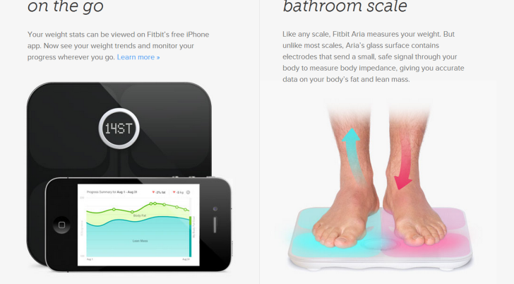
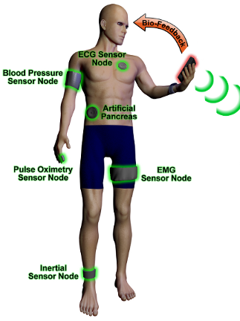
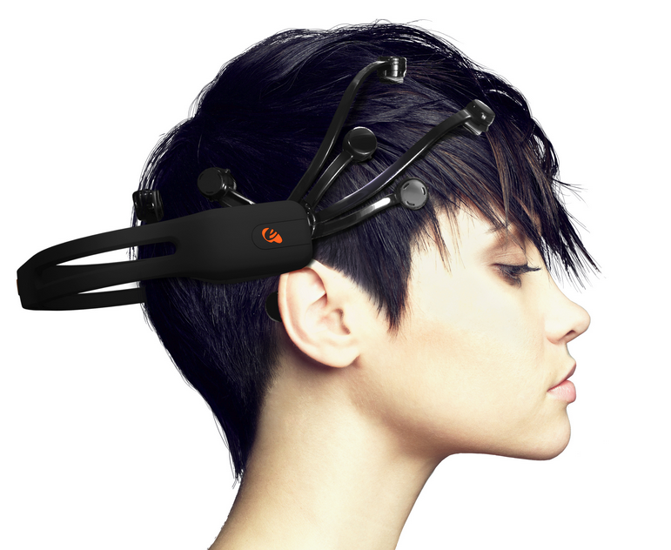

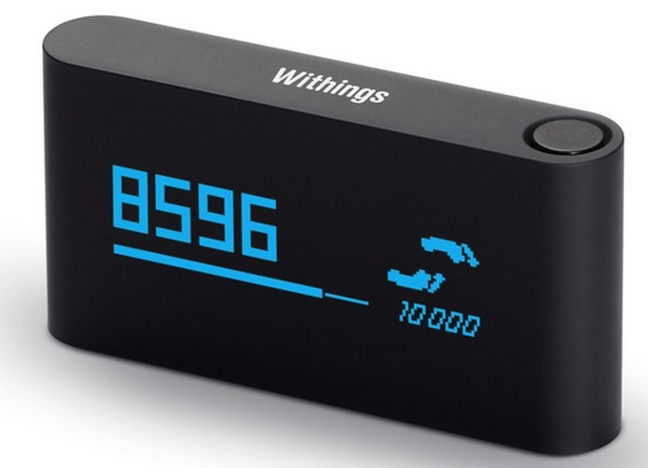
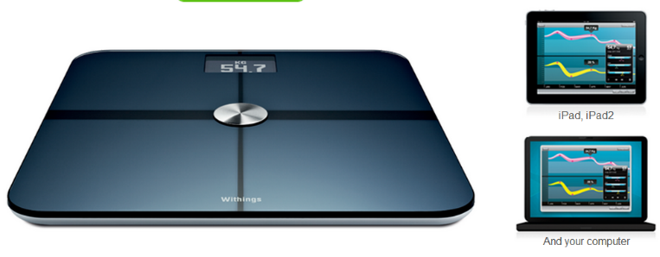
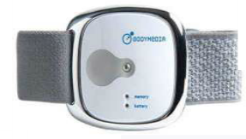
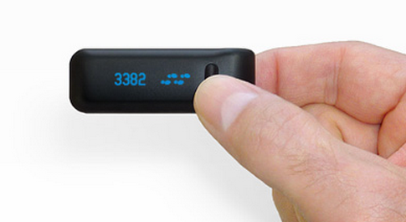
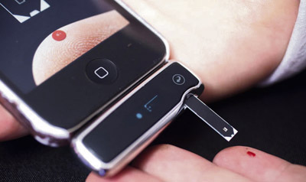
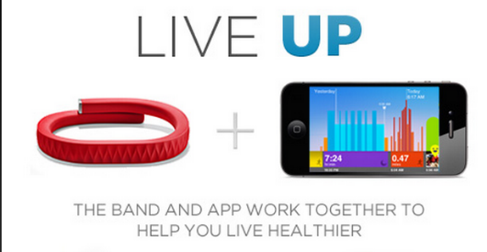
Sensor Technology Innovation
3

Slide 4
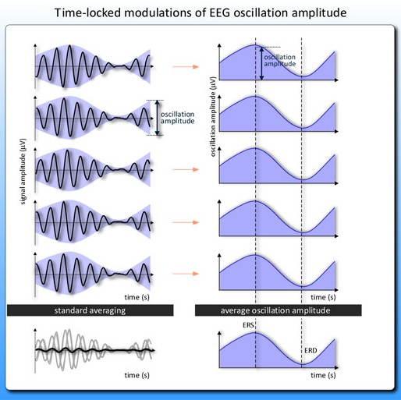
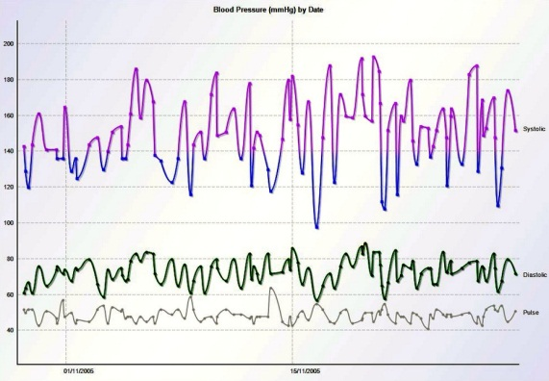
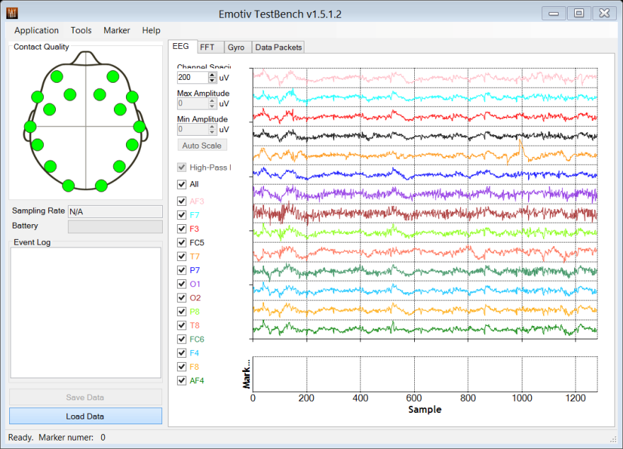
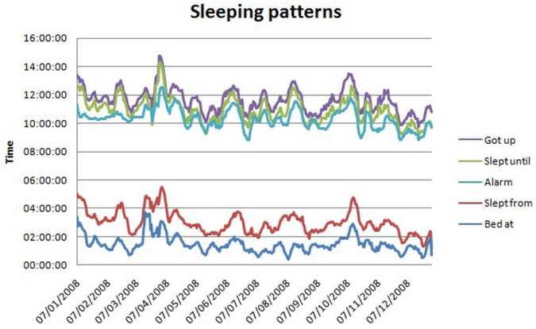
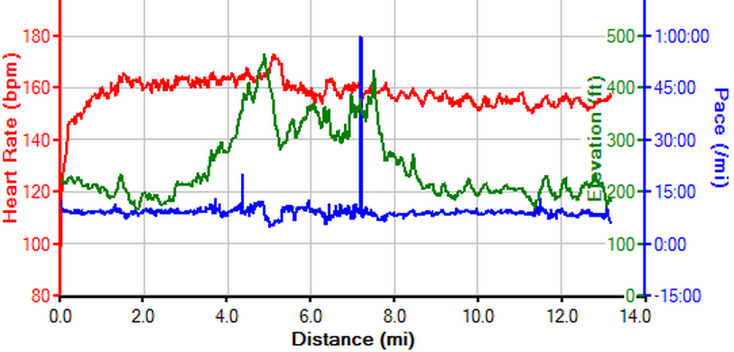
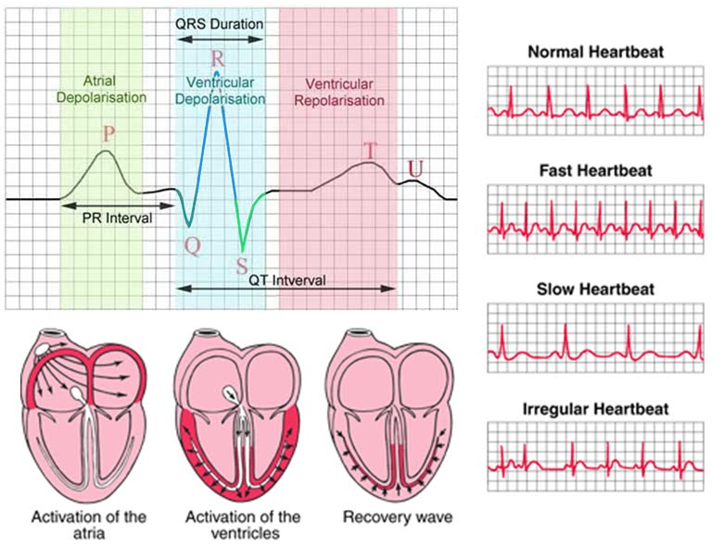
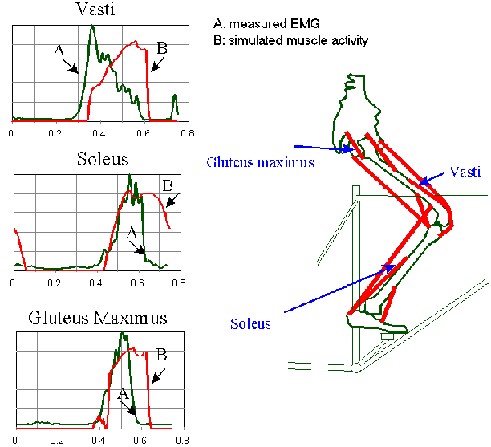
The Coming Big Data Explosion!
4

Slide 5
Challenges
Data volume and variety:
Data comes from high-resolution and large medical imaging data like X-rays and CT scans to simple numerical data of systolic and diastolic pressure measurement figures from the blood pressure device.
Data access and query:
Handle a wide range of data queries using different metrics such as timestamps, values, sensor metadata and tags.
Sophisticated security mechanisms to ensure adequate and accurate security control over the data without compromising performance.
Data Analysis & Collaboration
Capability of processing and analysing large amount of data
Allow data and expert knowledge to be exchanged or shared in an efficient manner.

Slide 6
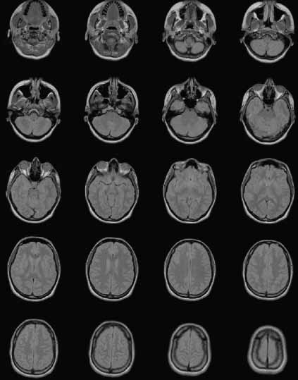
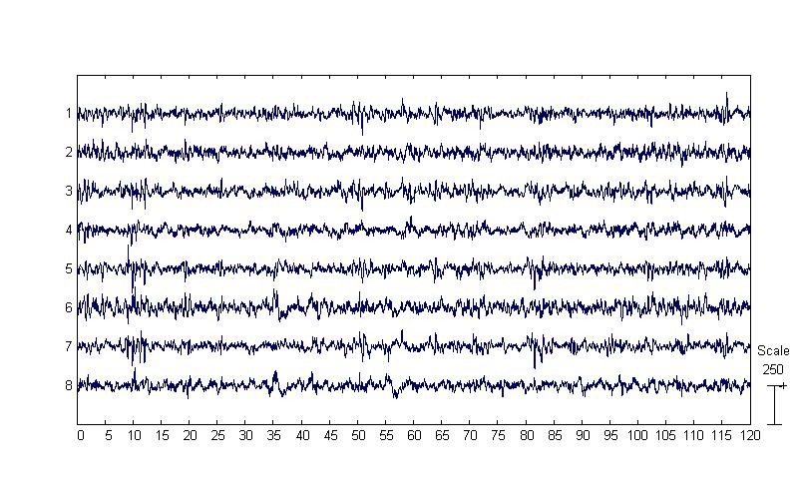
Various Types of Data
Unstructured Sensor Data
Video and Imaging Files (such as PET, CT, fMRI, X-Ray)
Semi-Structured/Structured/Time-Series Sensor Data
Heart Rate/ECG, EEG, Blood Pressure, 3D accelerometer, GPS, SpO2, Body Temperature …..
Age, Height, Weight ….
 | Full body PET | CT Cardiac | fMRI
Images / set | 600 | 3000 | 20000
Size of 1 set | 1.2 GB | 6 GB | 40 GB
No. of sets (typical) | 4 | 6 | 8
Exam Size | 9 GB | 36 GB | 300 GB

Slide 7
Wiki-Health Platform
Big data infrastructure
Secured open environment
Scalable data storage
Data access API
Data collection tools
Data analysis tools and frameworks
Data collaboration environment
Notes:
A big data infrastructure that supports not just storage and management of health sensor data, but also your “life”, “wellbeing” and all kinds of data that can reflect your health and fitness status.
An secured open environment, a place you can share your data to the ones you wanted at the given time and conditions, such as to your relatives, care givers and doctors
Data analysis tools and frameworks to support analysis your data and generate a set of personalized health assessment
To enable scientists, doctors and even yourself to explore more meaningful elements from long term monitoring on your daily activities, sleep patterns and body measurements.

Slide 8
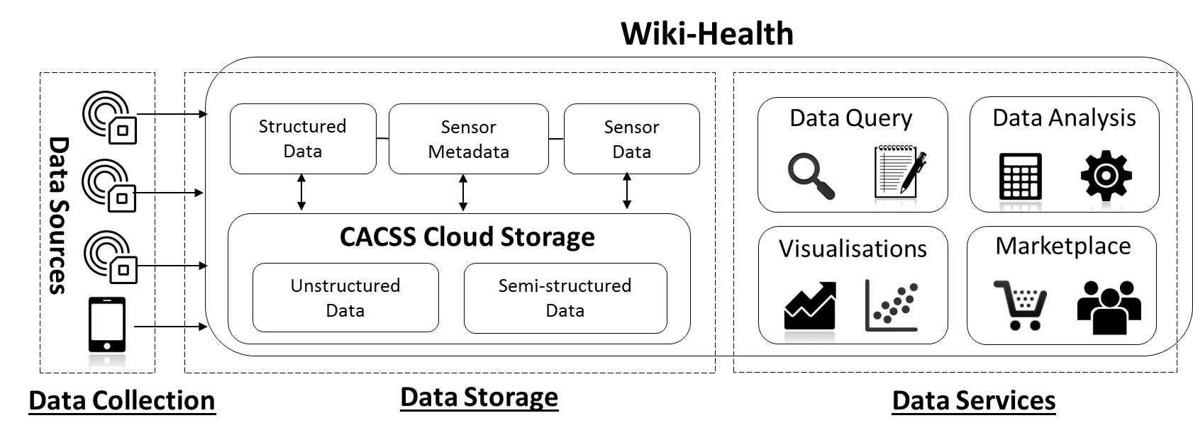
Wiki-Health – The Big Picture

Slide 9
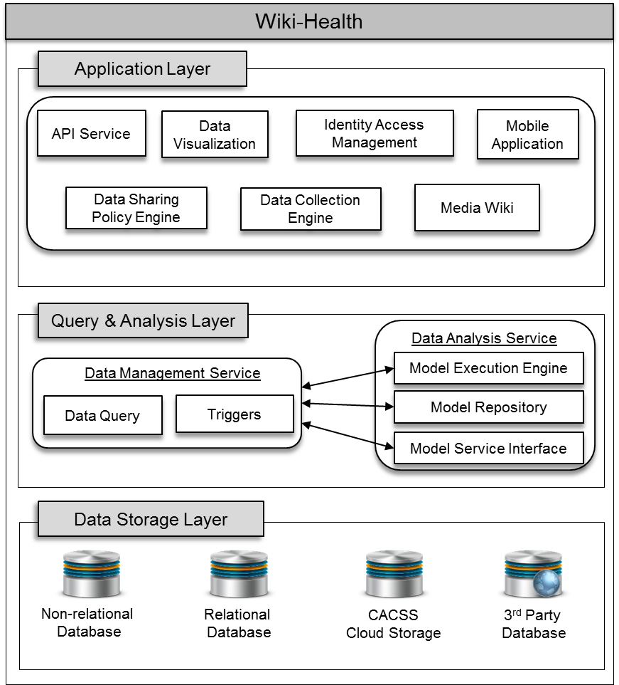
Wiki-Health Platform Architecture – Components

Slide 10
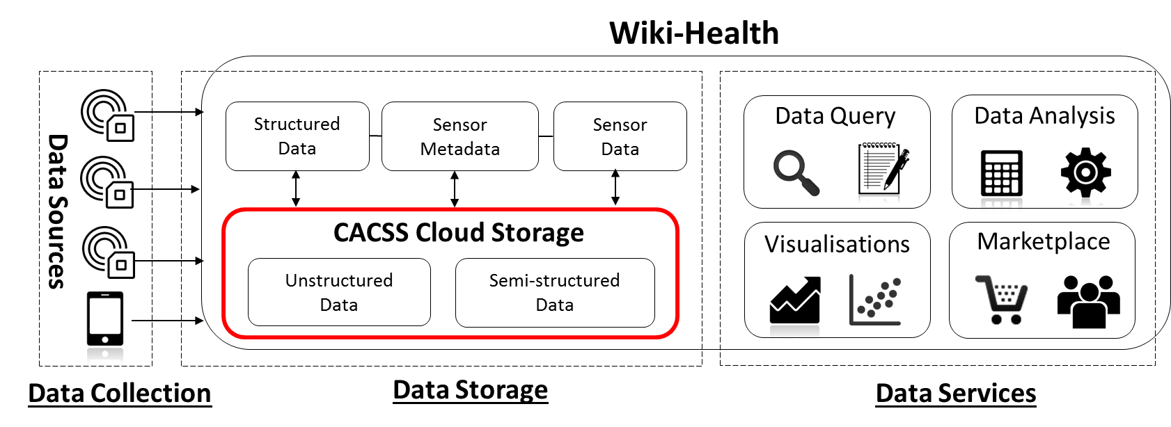
Wiki-Health Unstructured and Semi-Structured Data Management

Slide 11
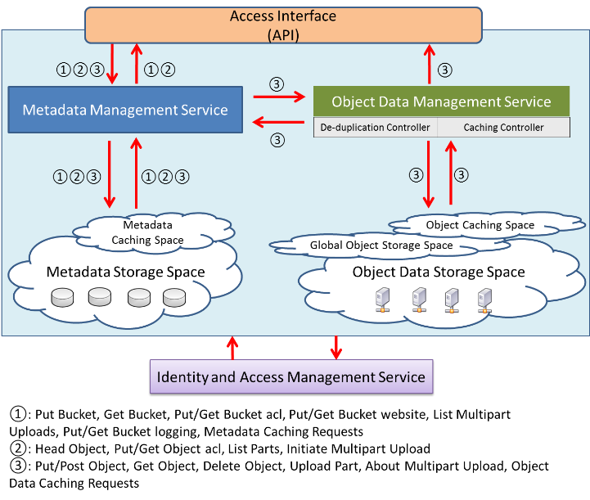
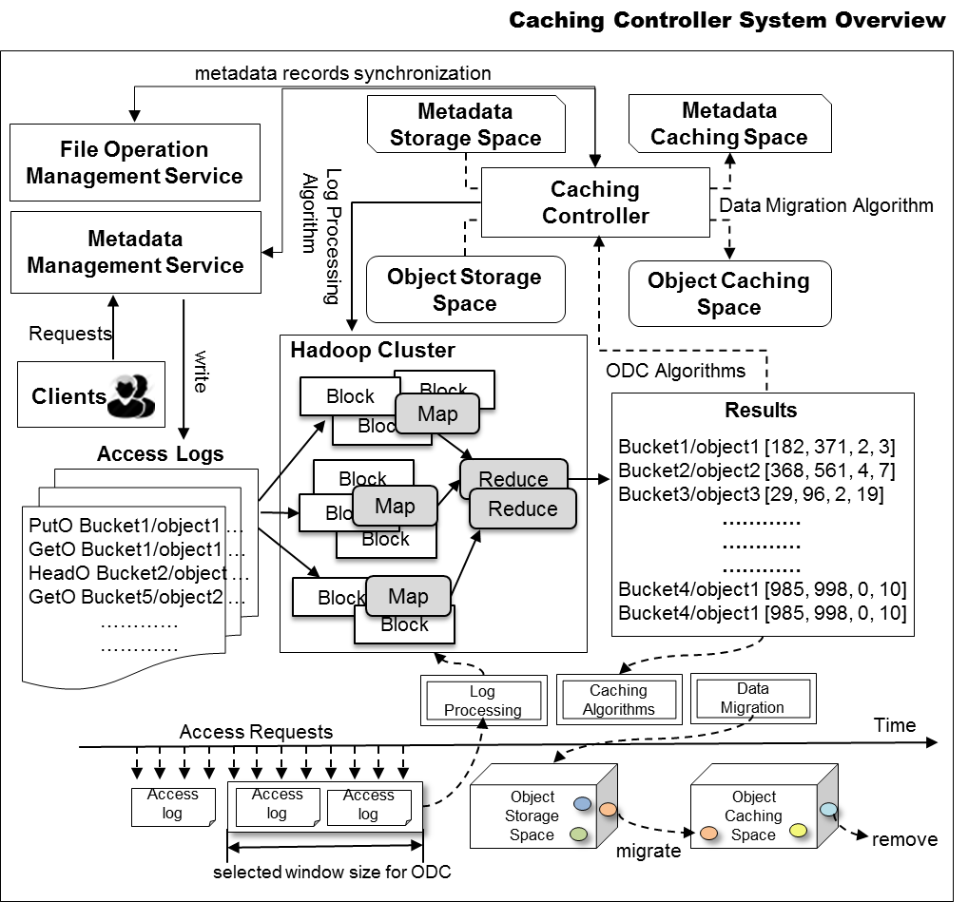
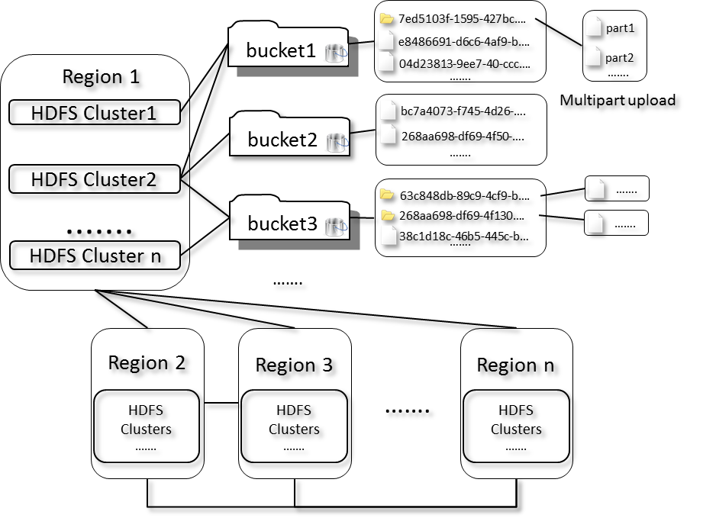
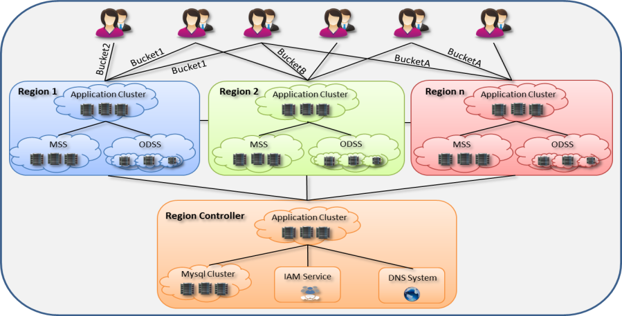
Wiki-Health Unstructured and Semi-Structured Data Management

Slide 12
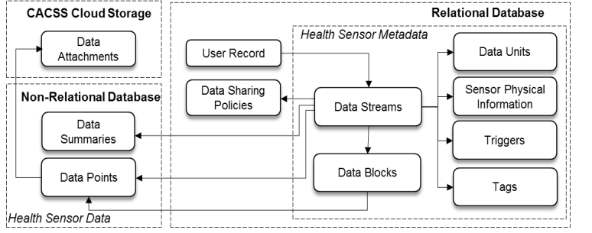
Data Storage Structure
Hybrid Data Storage: CACSS Cloud Storage and NoSQL database
Handle all kinds of sensor data

Slide 13
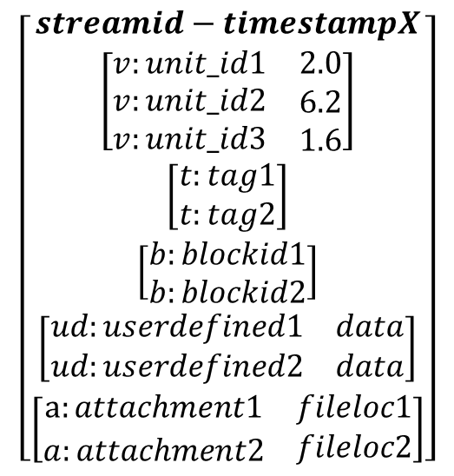
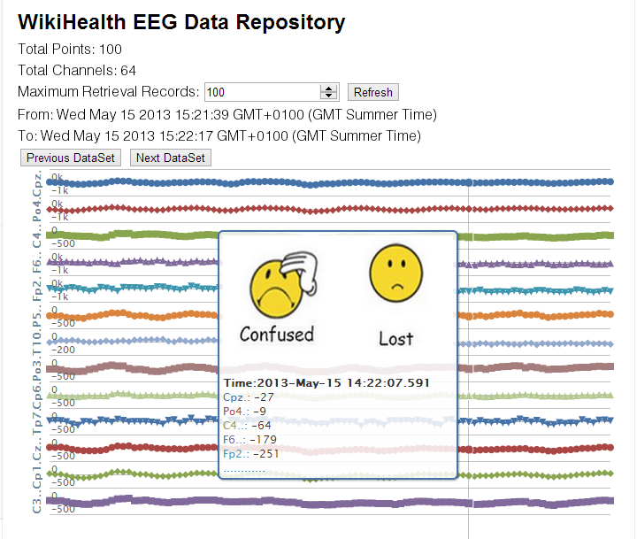
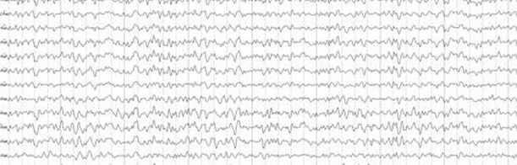
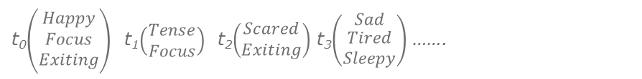
Data Tagging and Labelling
Support multiple channels data structure
Support tagging on particular region of the data stream
t₀$\left(\begin{matrix}Happy \\ Focus \\ Exiting\end{matrix}\right)$ t₁$\left(\begin{matrix}Tense \\ Focus\end{matrix}\right)$ t₂$\left(\begin{matrix}Scared \\ Exiting\end{matrix}\right)$ t₃$\left(\begin{matrix}Sad \\ \begin{aligned}Tired \\ Sleepy\end{aligned}\end{matrix}\right)$ …….

Slide 14
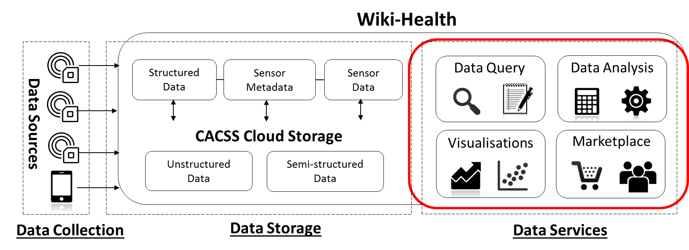
Wiki-Health Data Services

Slide 15
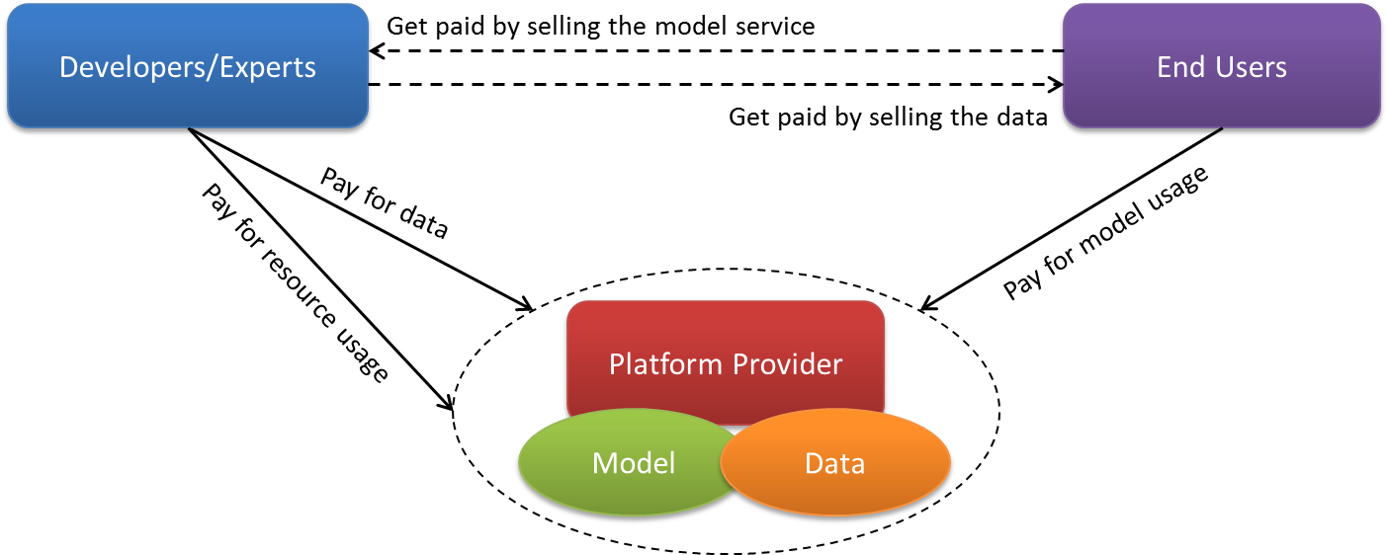
Wiki-Health Data Services
Allow scientists, developers and professionals to publish their data analysis models as services
Allow users to pay for the published services and obtain analysis results
Allow users to sell their collected data and analysis results to other parties

Slide 16
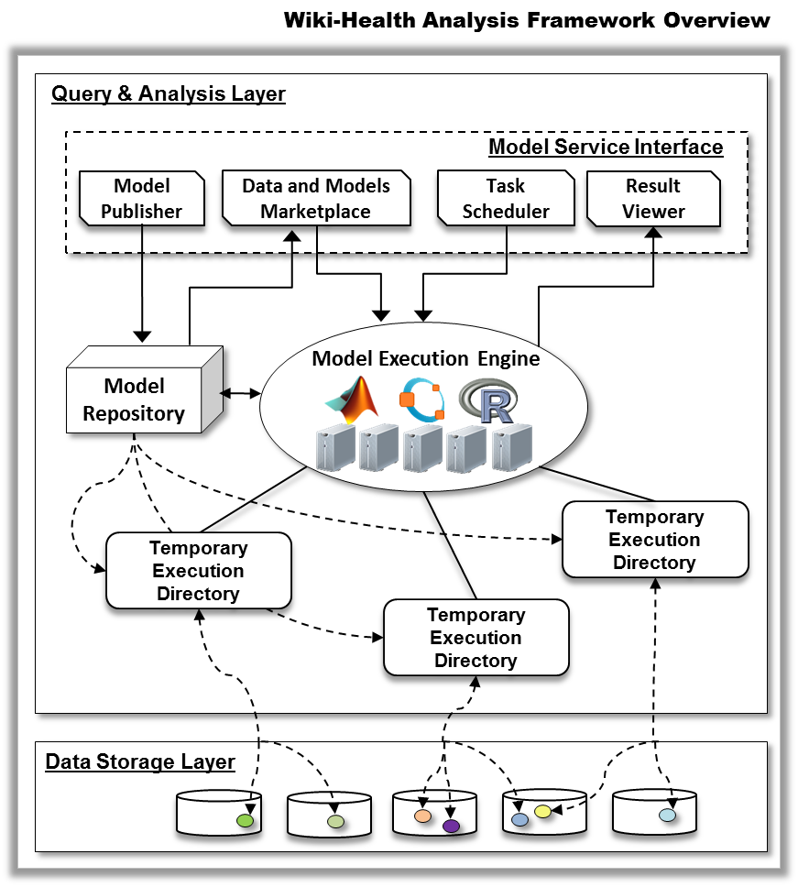
Wiki-Health Data Services

Slide 17
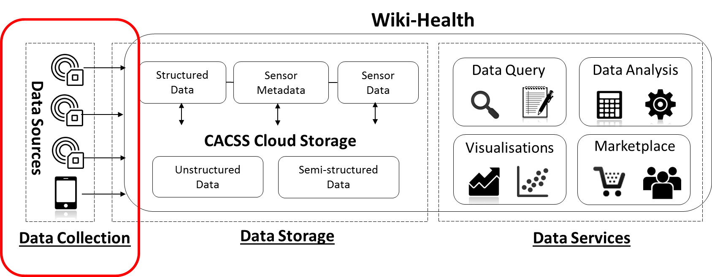
Wiki-Health Data Collections and Tools

Slide 18
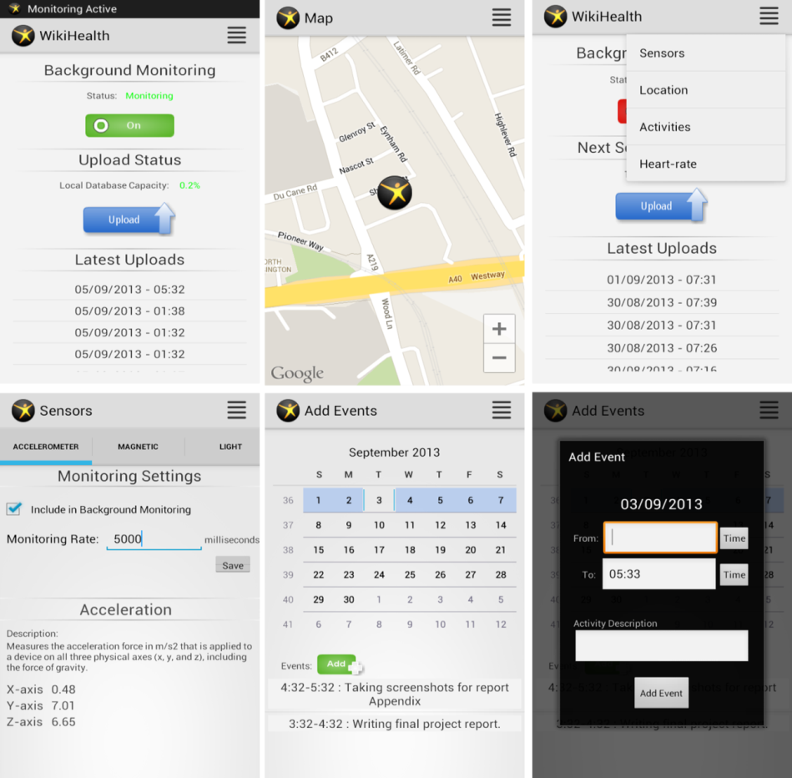
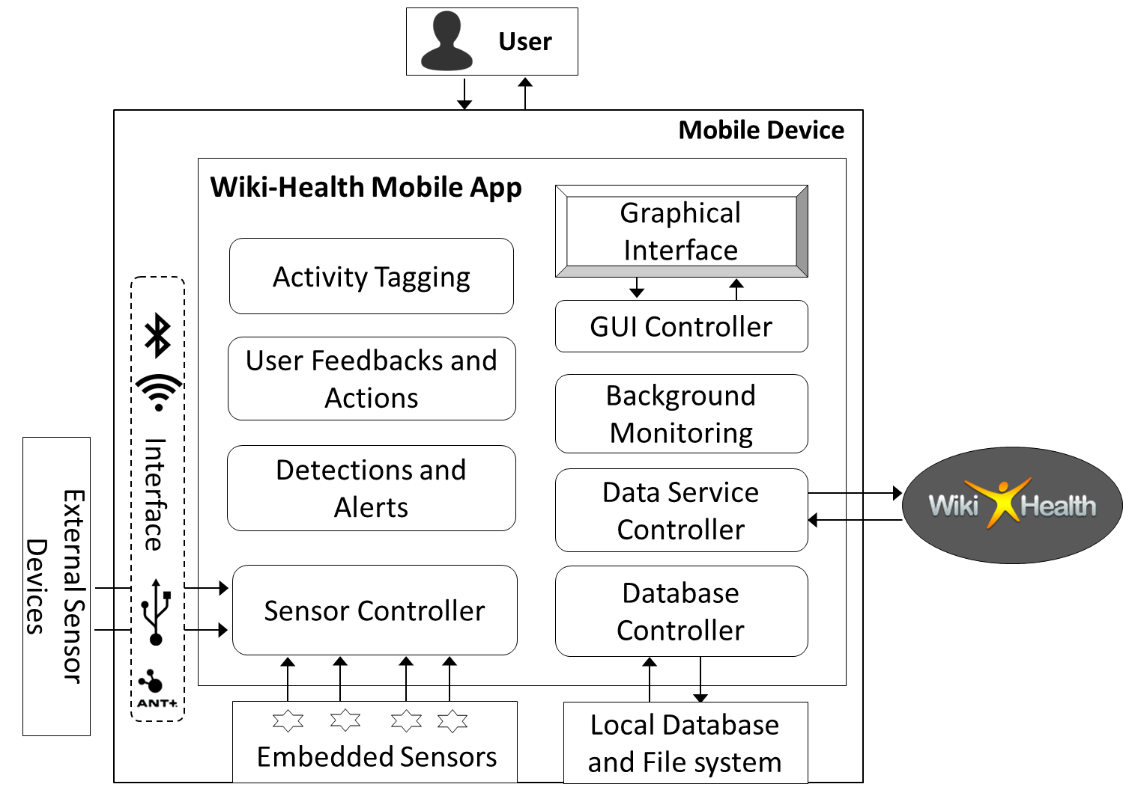
Wiki-Health Mobile App
Collect and upload data to Wiki-Health platform through API
Connect built-in sensors: accelerometer, GPS
Connect external sensors: ECG, EEG
Activity Tagging
Alerts and Feedbacks

Slide 19

Wiki-Health Data Viewer
Live at http://wikihealth.bigdatapro.org

Slide 20

Wiki-Health API
Live at http://wikihealth.bigdatapro.org/api/

Slide 21


Wiki-Health Data Analysis SDK

Slide 22
Evaluation and Case Studies

Slide 23

Wiki-Health - Virtual Sensing as Service
Virtual sensors can provide indirect measurements by using other available sensor data.
Integrate environmental and geographic data, personal sensor data and physiological models together to compute and simulate virtual sensor readings.

Slide 24

Wiki-Health - Virtual Sensing as Service Integrate human physiology models
Example of simulating full body temperatures and energy transformation
Core body temperature & Safety
Too high: heat exhaustion, heatstroke
Too low: hypothermia
Age: 27, Weight：80kg
1- 60 min running at a speed of 6mph with air temperature 30°C
60-120 min sit still with air temperature 42°C
120-180 min sit still with air temperature 10°C
180-240 min running at a speed of 6mph with air temperature 10°C

Slide 25
Wiki-Health – ECG-based Personal Health Monitoring as Service
In 2011, nearly 160,000 people died in the UK from Cardiovascular disease (CVD). CVD-related healthcare costs to the UK’s NHS in total is £15.7 billion, 21% of overall NHS expenditure.
Problem with traditional approach: reactive, treating problems at the crisis level
Better approach: proactive health management approach, discover and address issues at an early stage

Slide 26

Data Analysis Method for ECG-based Health Monitoring Service
Electrocardiogram (ECG): is the recording of the electrical activity of the heart. It is a non-invasive procedure and one of the most widely used physiological signals for medical diagnoses.
Cardiovascular problems, abnormal levels of specific minerals in the blood, and observe effects of drugs used to regulate the heart
Notes:
Traditionally, a standard ECG screening records the electrical activity of your heart for only a few minutes and the procedure is carried out in a hospital. When symptoms persist and a definitive diagnosis cannot be determined using a standard ECG, a Holter monitor––a small, battery-operated wearable device that tracks the patient’s heart rhythms—will be used to record 24 to 48 hours of ECG signals. Patients then return the monitors to their doctors. Efforts are being made to enable remote monitoring of such ECG-monitoring systems. For example, the AliveCor device [20, 21] is one of a growing number of health sensors that not only allow users to record and view medical grade single-channel ECG signals on a smartphone/tablet, but also to upload and share their recordings directly with their physicians or cardiologists through the internet.
The QRS complex is one of the most key information components extracted from a patient’s overall ECG signals to help doctors in diagnosing and tracking the change. The QRS complex is a specific sequence of deflections seen on a printout of typical ECG signals. It represents the depolarization of the right and left ventricles of the human heart. Normally the heart beats in a regular and rhythmic way producing a P wave, a QRS complex and a T wave. These waves are useful in helping doctors and health professionals diagnose cardiovascular problems, identify abnormal levels of specific minerals in the blood, and observe the effects of drugs used to regulate the heart.

Slide 27

Wiki-Health – ECG-based Personal Health Monitoring as Service
Build Personal ECG Model through long term ECG monitoring (e.g. 1 month).
Monitor and detect significant changes in a person’s heart conditions.
Trigger alerts and request feedbacks

Slide 28

Data Analysis Method for ECG-based Health Monitoring Service
Personal ECG Model (PEM)
Global Model of Abnormalities (GMA)

Slide 29
Data Analysis Method for ECG-based Health Monitoring Service
Data Pre-processing
moving average filter
wavelet transformation

Slide 30
Data Analysis Method for ECG-based Health Monitoring Service
Beat Blocks
Pan and Tompkins
Block Window of 0.6 second

Slide 31
Data Analysis Method for ECG-based Health Monitoring Service
Features
Signal features:
60 linearly spaced bins for signal features between amplitude of -0.3 and 0.5.
Spectral features:
One-sided discrete Fourier transform (ODFS) of each beat block
Pass band of [0,20] Hz
Use both real and imaginary parts as features, 80 spectral features in total
Classifiers
One-Class Support Vector Machine (Estimating the Support of a High-Dimensional Distribution by Schölkopf et al. 2001)
Adaptive Learning Approach for Personal ECG Model
K-Nearest Neighbor (K-NN) algorithm for Global Model of Abnormalities
Notes:
Different from classical SVM, it uses two classes for training. OCSVM only requires data from one class in the training stage and is able to classify if newly encountered data belong to the same class or not. Therefore, it is used for detecting personal abnormal or unusual beats.

Slide 32

Adaptive Learning Approach for Personal ECG Model
Constructs a cluster of weighted classifiers
Add new classifiers that are trained using only the new data
Updates the weights of classifiers based on the previous prediction results
Taking the votes from all the available classifiers from the cluster for prediction
Notes:
Constructs a cluster of weighted classfiers
Instead of re-training one model with all the existing data, ALA adds new classifiers that are trained using only the new data, and updates the weights of classifiers based on the previous prediction results, i.e. feedbacks from doctors. The prediction is accomplished by taking the votes from all the available classifiers from the cluster.

Slide 33
Classification for Global Model of Abnormalities
K-Nearest Neighbor (K-NN) algorithm
For the global training and classifications for GMA
To determine the nearest neighbour, various distance measures have been investigated:
Notes:
Constructs a cluster of weighted classfiers
Instead of re-training one model with all the existing data, ALA adds new classifiers that are trained using only the new data, and updates the weights of classifiers based on the previous prediction results, i.e. feedbacks from doctors. The prediction is accomplished by taking the votes from all the available classifiers from the cluster.

Slide 34
Implementation
All the models and executing function files are uploaded into the Wiki-Health’s model repository and published as a health monitoring service in the data and models marketplace.
Notes:
Traditionally, a standard ECG screening records the electrical activity of your heart for only a few minutes and the procedure is carried out in a hospital. When symptoms persist and a definitive diagnosis cannot be determined using a standard ECG, a Holter monitor––a small, battery-operated wearable device that tracks the patient’s heart rhythms—will be used to record 24 to 48 hours of ECG signals. Patients then return the monitors to their doctors. Efforts are being made to enable remote monitoring of such ECG-monitoring systems. For example, the AliveCor device [20, 21] is one of a growing number of health sensors that not only allow users to record and view medical grade single-channel ECG signals on a smartphone/tablet, but also to upload and share their recordings directly with their physicians or cardiologists through the internet.
The QRS complex is one of the most key information components extracted from a patient’s overall ECG signals to help doctors in diagnosing and tracking the change. The QRS complex is a specific sequence of deflections seen on a printout of typical ECG signals. It represents the depolarization of the right and left ventricles of the human heart. Normally the heart beats in a regular and rhythmic way producing a P wave, a QRS complex and a T wave. These waves are useful in helping doctors and health professionals diagnose cardiovascular problems, identify abnormal levels of specific minerals in the blood, and observe the effects of drugs used to regulate the heart.

Slide 35

Implementation : Integration Analysis Models with Wiki-Health Platform
The user only needs to select the service from the data and models marketplace, configure the mappings of inputs and outputs to be used for the health monitoring service.
Notes:
For users, the enabling of a personal health monitoring service with Wiki-Health requires almost no knowledge about the computation. The user only needs to select the service from the data and models marketplace, configure the mappings of inputs and outputs (such as selecting the ECG data stream) to be used for the health monitoring service and enter the email address of the doctor for triggered alerts.

Slide 36

Experimental Evaluation
ECG records from the MIT-BIH database have been used for the experiments.
Experiment A: Test the performance of the selected features with single fixed one-class SVM:
average classification rate of 85.5%, specificity 81.1%, and sensitivity 98.1%.
Experiment B: Test the effectiveness of the Adaptive Learning Approach.
Simulated the scenario of adding 500 training samples each time
Reduce the time of training and updating the PEM model significantly compared to using a single classifier.
average classification rate of 92.2%, specificity 88.9%, and sensitivity 96.6%.
$Classification Rate=\frac{TP+TN }{TB }$
$Specificity=\frac{TN }{FP+TN}$
$Sensitivity=\frac{TP }{TP+FN}$
Notes:
For users, the enabling of a personal health monitoring service with Wiki-Health requires almost no knowledge about the computation. The user only needs to select the service from the data and models marketplace, configure the mappings of inputs and outputs (such as selecting the ECG data stream) to be used for the health monitoring service and enter the email address of the doctor for triggered alerts.

Slide 37
Conclusion
The key components for enabling “Health Monitoring as a Service” in a cloud-based personal health sensor data management platform, named Wiki-Health have been presented.
The possibility of detecting personal ECG abnormalities using the One-Class Support Vector Machine is investigated and proven to be effective using the combination of beat blocks and selected features.
The proposed ALA within the analysis model is able to reduce the training time necessary for updating the model on received feedback, while showing improved performance over existing methods.
Notes:
Wiki-Health is a cloud-based big data platform for health sensor data management. We introduced a new collaborative approach for health sensor data management that not only allows users to collect, label, tag, annotate, update and share sensor data, but also allow users to create, reuse and remix data analysis results and models.
The positive performance of the approach is supported by the results obtained in the experimental trials and shows significant potential for real-world applications.
The approach we propose offers enterprises and the research community considerable advantage in combining existing technologies such as cloud computing, cloud storage and other tools in developing and extend our work towards a successful collaborative health sensor data management system.

Slide 38



Wiki-Health Electroencephalography Data Analysis
EEG: Measures the electrical activity of the brain
Data Collection:
EEG neuroheadset
Monitoring of 14 locations of the brain
EEG data processing
Conscious thoughts detection
Face Expression detection
Emotion recognition

Slide 39



Wiki-Health EEG - Brain Training

Slide 40

Wiki-Health EEG – Which visualization is more exciting?
Two types of visualizations
Paired Experiment
Slideshow while Recording EEG data and Time
10 subjects

Slide 41


Wiki-Health EEG – Which visualization is more exciting?

